Slide 1
Use of Placebos in Controlled Trials

Slide 2
Background
The traditional ‘double-blind’ Randomised Controlled Trial uses a placebo to conceal allocation.
There are a number of advantages to using a placebo that reduces non-selection bias.

Slide 3
Forms of Placebos
A placebo should look feel and taste the same as the active treatment, sometimes this is difficult.
Sham surgery is sometimes used as a ‘placebo’ surgery.
Placebo ‘talk’ therapy in psychological therapies.

Slide 4
Reduction in Subversion Bias
A placebo ‘blinds’ or masks the following:
  Doctor
  Patient
  Assessor
This reduces the possibility of subversion as the person recruiting the patient is ‘blind’ to treatment allocation and therefore cannot subvert. HOWEVER, drug codes can be cracked and subversion therefore can occur.

Slide 5
For example
Sometimes placebos come in different bottles or labelled differently if someone manages to crack the code then all allocations are unmasked.

Slide 6
Hawthorne Effect and Resentful Demoralization
Because patients do not know if they are on active treatment or not they will not be demoralised if they do not get active treatment.
All patients are taking a similar looking treatment and therefore they should all have the Hawthorne effect.

Slide 7
Ascertainment Bias
Because patients are on placebos they are not likely to differentially report events due to knowledge of their treatment. This means any differences can be more likely ascribed to treatment rather ascertainment bias.
Also assessors are blinded because of placebos.

Slide 8
Explanatory Effects
Because placebos eliminate bias they are more likely to produce a ‘truer’ estimate of a therapeutic effect than an ‘open’ trial.
There are however, problems through using placebo control.

Slide 9
Technical Problems
It is not UNKNOWN for placebos to actually be an active treatment
Mistakenly at least one trial labelled active drugs as placebo so ALL patients got active treatment – showing no effect.
Placebos can be unmasked.

Slide 10
Active or Inactive placebos
Sometimes a placebo may not be totally ‘inert’.
For example, some wound care trials have used ‘placebo’ gel, which may actually have had a beneficial or harmful effect on the wound.
Often trials used ‘active’ placebos as it is unethical to allocate an inactive placebo. May be difficult to develop placebo.

Slide 11
Placebos Unmasked
For some treatments placebo control is difficult as active treatment produces an effect which immediately unblinds the person taking it (and/or their clinician).
This process can reduce the usefulness of a placebo as the unmasked patients can differentially respond.

Slide 12
Surgical Placebos
Sham or placebo surgery is sometimes used to mask the patient to their treatment (hopefully surgeon hasn’t been blinded).
Many think this is unethical as the control patients are exposed to harm (e.g. infection risk, anaesthesia) with no possibility of benefit.

Slide 13
Drawbacks of Placebos
For many treatments a placebo cannot be used (e.g most surgery).
Even when a placebo can be used it may not produce the most useful answer.
It may be better NOT to use a placebo.

Slide 14
Efficacy or Effectiveness?
In routine clinical practice placebos are not used.
The EFFECT of a treatment is the EFFICACY of the biological effect of treatment plus any benefit due to the ‘placebo’ effect.
Using placebos efficacy is estimated NOT effectiveness.

Slide 15
Trial of Antibiotics
Little and colleagues undertook an RCT of antibiotics for sore throat.
They could have used placebos but chose instead to use an ‘open’ design.
In the initial study it was shown that the use of antibiotics had NO effect on sore throat.

Slide 16
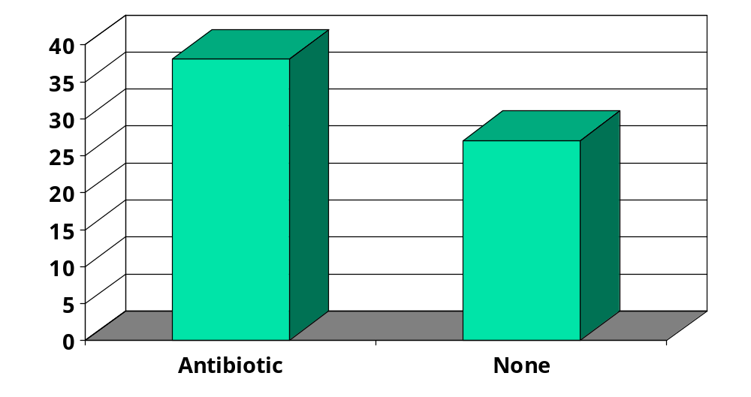
Number of patients returning for more treatment
Little et al. BMJ 1997;315:350-52.

Slide 17
Antibiotics
In the Little study it was shown that participants randomised to antibiotics mistakenly attributed their improvement to treatment and therefore were more likely to re-attend their GP during the next episode of sore throat.
A placebo trial would NOT have found this result.

Slide 18
Placebos and Recruitment
Gossip (i.e., qualitative data) suggests that recruitment may be better in a non-placebo trial.
More robustly an RCT of placebos has indicated participants are more willing to take part in an ‘open’ rather than a placebo trial.

Slide 19
The ‘OPEN’ Trial
An RCT of randomising men and women (70+) to be asked whether or not they would take part in a fracture prevention trial examined the question of trial recruitment.
The aim was to test the hypothesis that open trials recruited better than placebo studies.

Slide 20
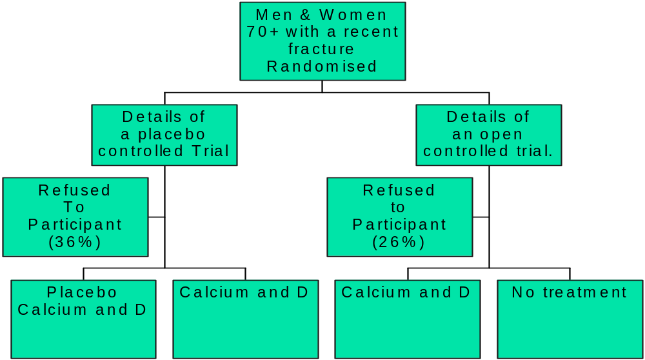
Diagram of OPEN trial

Slide 21


Slide 22
Diagram of OPEN trial

Slide 23
Trial retention
To avoid bias it is CRUCIAL that after randomisation as many participants are retained within the trial as possible.
Using an OPEN design we might expect that those randomised to no treatment might drop out to seek treatment elsewhere.
Important to test this – fortunately, Avenell and colleagues did so.

Slide 24
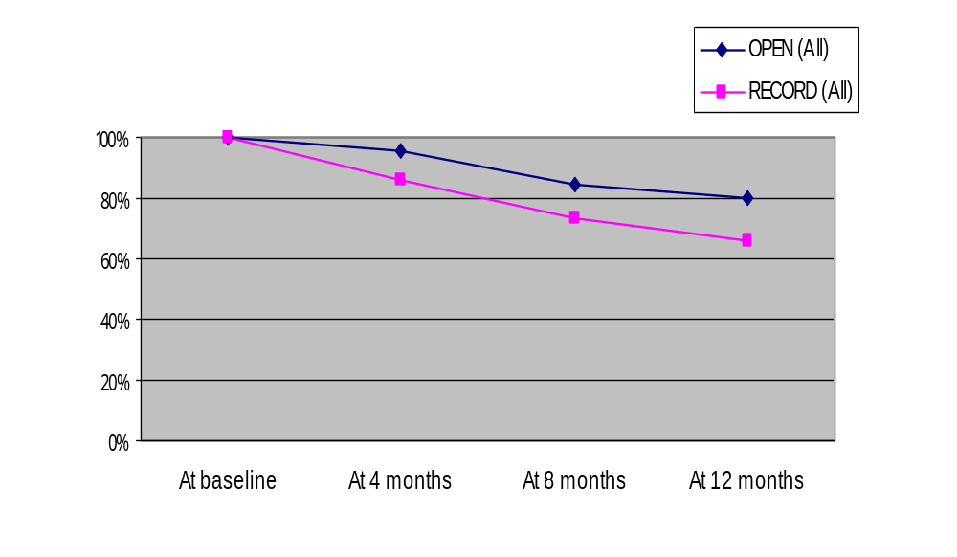
Retention Rates: Placebo vs Open

Slide 25
Overall retention
This seemed to be better in the open trial compared with the placebo study.
BUT was active group being retained more often than the open treatment group?

Slide 26
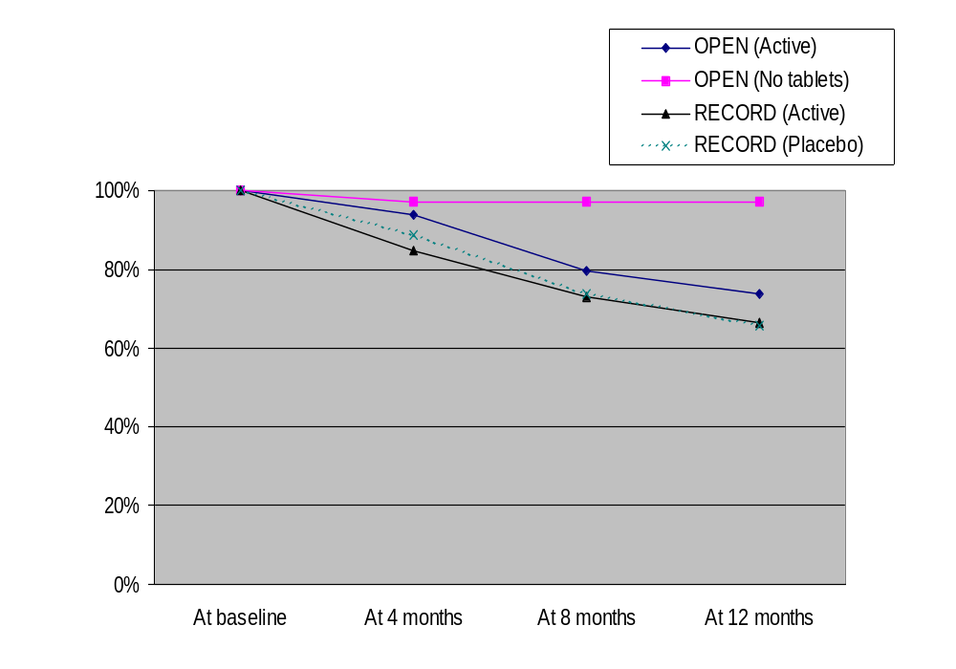
Retention Rates by Group

Slide 27
The OPEN trial again
Interestingly the drop out rate in the OPEN trial is lowest in the NO treatment group. This is CONTRARY to expectations as we assumed this would be the highest.
LESSON – Trialists need to test trial ideas in RANDOMISED TRIALS.

Slide 28
Another ‘OPEN’ trial
Hemminki using similar methods as Avenell et al, randomised 4,295 women to take part in a placebo controlled trial of HRT or an open trial of HRT.
Those randomised to the open approach 48% were recruited compared with 37% for placebo group. The difference 11% was significant and similar to the Avenell study.
Hemminki et al. J Clin Epidemiol 2004;57:1237.

Slide 29
Placebos - conclusions
For phase 1 & II trials placebos are useful to make sure there is a ‘true’ physiological or psychological effect. Their use, however, is not problem free.
They are probably used TOO frequently for phase III or IV trials.

Slide 30
Summary
Placebos are effective at removing some forms of bias.
Care needs to be taken that placebos are developed correctly.
Placebos are not PRAGMATIC and can lead to results that are not replicable in normal care.

